Slide 1
Data Driven Approach to a Successful Cloud Migration
{{val:sf--intro.csv[1:2]}}
Analysis for System: {{val:sf--intro.csv[1:1]}}
{{val:sf--intro.csv[1:8]}}, {{val:sf--intro.csv[1:9]}}
{{val:sf--intro.csv[1:7]}}

Slide 2
Agenda
Plan for Ongoing Success in the Cloud
BigQuery Background
Key System Metrics
System Analysis
Data Transfer
Architectural Consideration
System Platform Limitations
Dictionary and Schema Analysis
Summary

Slide 3
Plan for Ongoing Success in the Cloud
Getting a Lay of the Land

Slide 4

Cloud is the Future of Infrastructure But not all Cloud Software is Equal
Understanding the lay of the land helps to avoid problems in advance

Slide 5




Vantage Platform Consumption Analysis
To provide a high–level view of the platform environment
Consumption
Indexes
Columns
Quotas
Dictionary Analysis

Slide 6
Key System Metrics
{{val:sf--intro.csv[1:1]}}

Slide 7
Key System Metrics
Summary
{{val:sf--query_counts.csv[1:11]}}B
Annual queries
{{val:sf--appid_counts.csv[1:3]}}
Applications on same platform
{{val:sf--query_counts.csv[1:8]}}M
Average queries per month
{{val:sf--query_counts.csv[1:6]}}M
Average queries per day
{{val:sf--user_counts.csv[1:3]}}
Active users, business and applications
{{val:sf--query_counts.csv[1:15]}} secs
Average response time
{{val:sf--concurrency.csv[1:5]}}
Concurrent queries (peak)

Slide 8
Key System Metrics
Total Users | {{val:sf--user_counts.csv[1:2]}}
Active Users | {{val:sf--user_counts.csv[1:3]}}
Tables | {{val:sf--object_counts.csv[1:2]}}
Views | {{val:sf--object_counts.csv[1:3]}}
Programs | {{val:sf--object_counts.csv[1:4]}}
Other | {{val:sf--object_counts.csv[1:5]}}
Queries per Second | {{val:sf--query_counts.csv[1:4]}}
Queries per Day | {{val:sf--query_counts.csv[1:5]}}
Queries per Year | {{val:sf--query_counts.csv[1:9]}}
Maximum Space Available (TB) | {{val:sf--diskspace.csv[1:3]}}
Current Space Used (TB) | {{val:sf--diskspace.csv[1:5]}}
Absolute Peak | {{val:sf--concurrency.csv[1:5]}}
95th Percentile | {{val:sf--concurrency.csv[1:4]}}
50th Percentile / Average | {{val:sf--concurrency.csv[1:2]}}
Average Query Runtime, Seconds | {{val:sf--query_counts.csv[1:15]}}
USERS
OBJECTS
QUERY
DISK SPACE
CONCURRENCY
Notes:
REPLACE02

Slide 9
System Analysis
Associated Migration Challenges

Slide 10
Data Transfers

Slide 11


Ingress and Egress Issues
Ingress of Data
Depends greatly on the connectivity between customers and their cloud providers
No cost
Potential data transfer bottleneck
Egress Charges
Cloud Service Providers like to keep data in and not let it out
“Usually cloud providers charge between 5 and 20 cents per GB every time you move your data from their cloud storage…”
Notes:
https://www.hostdime.com/blog/data-egress-fees-cloud/

Slide 12

Daily Data Transfers
customize
placeholder
text
{{pic:sf--data_transfer.png}}
Inbound
In general, inbound data traffic is significantly lower than outbound traffic for customers, as Vantage excels at large scale analytics in a read-once, use-many architecture.
Outbound
The outbound traffic is helpful in calculating data egress cost after moving to the cloud. Also helps customers to understand where the data gravity lies in the Ecosystem.

Slide 13
Architectural Considerations

Slide 14

Daily Queries Throughput
Headline placeholder
Sed elementum turpis orci, non mattis mauris viverra quis. Cras condimentum augue Bibendum.
customize
placeholder
text
Average {{val:sf--subsecond_query.csv[1:8]}}M per day. {{val:sf--subsecond_query.csv[1:7]}} % of the queries are sub-second
Headline placeholder
Sed elementum turpis orci, non mattis mauris viverra quis. Cras condimentum augue Bibendum.
XXXX
{{pic:sf--daily_query_throughput.png}}
XXXX

Slide 15
JOIN Frequency
Frequent Multi-Table JOINs
{{pic:sf--join_frequency.png}}
Achieving Strategic Goals via Tactical Queries
Tactical queries cost very little in Vantage.
Single Table queries account for {{val:sf--join_frequency_horz.csv[1:8]}} of the total workload but only consume {{val:sf--join_frequency_horz.csv[1:21]}} of the total CPU. This efficiency enables millions of operational queries to be executed without impacting more complex strategic queries. The SLAs of all the workloads can be guaranteed through Teradata’s Advanced Workload Management capabilities.
Whilst the number of queries involving 6 or more tables represent only {{val:sf--join_frequency_horz.csv[1:13]}} of the total volume, in absolute numbers this still equates to more than {{val:sf--join_frequency_horz.csv[1:6]}} queries over {{val:sf--join_frequency_horz.csv[1:27]}} days. These complex strategic queries deliver the analytic value for the Enterprise.

Slide 16
Table Size > 10GB
customize
placeholder
text
{{val:sf--10GB_table_count.csv[1:2]}} Tables Exceed 10GB
DataBaseName | TableName | CurrentPerm GB
{{col:sf--10GB_tables.csv[2]}} | {{col:sf--10GB_tables.csv[3]}} | {{col:sf--10GB_tables.csv[4]}}
Forced Denormalization
Some lesser architectures force customers to denormalize. This means creating one pipeline per use which results in the scenario called “Pipeline Jungles.”
Notes:
REPLACE07

Slide 17

Applications and Data Extracts
customize
placeholder
text
Average Rows Returned
AppID | Total Queries | Total Fetched Rows | Avg Rows Per Query
{{col:sf--appid_detail.csv[1]}} | {{col:sf--appid_detail.csv[3]}} | {{col:sf--appid_detail.csv[4]}} | {{col:sf--appid_detail.csv[5]}}
Notes:
REPLACE08 -- sf--appid_detail.csv

Slide 18
Dictionary and Schema Analysis

Slide 19

Blockers to Successful Migration
Primary Indexes
Not having PI will require complete remodeling and will dramatically reduce performance, especially for tactical queries.
{{val:sf--constraints.csv[1:2]}} UPI Defined
Table Structures
SET tables enforce uniqueness automatically; absence of this capability will require moving this complex logic to ETL.
Global Temporary tables will need to be handled in the ETL, as well.
{{val:sf--tablekind_by_database.csv[1:5]}} SET tables out of {{val:sf--tablekind_by_database.csv[1:2]}} ({{val:sf--tablekind_by_database.csv[1:6]}})
{{val:sf--tablekind_by_database.csv[1:7]}} Global Temporary Tables
{{val:sf--tablekind_by_database.csv[1:4]}} Queue Tables
{{val:sf--tablekind_by_database.csv[1:3]}} Join Indexes
Constraints
All the constraints handled by the database would need to be handled by ETL, which will significantly increase ETL effort and can cause reconciliation issues.
{{val:sf--constraints.csv[1:6]}} Check Column Constraints
{{val:sf--constraints.csv[1:3]}} Primary Key Constraints
{{val:sf--constraints.csv[1:5]}} Foreign Key Constraints
Notes:
System database excluded:
DatabaseName NOT IN ('All', 'Crashdumps', 'DBC', 'dbcmngr’, 'Default', 'External_AP', 'EXTUSER', 'LockLogShredder', 'PUBLIC','Sys_Calendar', 'SysAdmin', 'SYSBAR', 'SYSJDBC', 'SYSLIB','SystemFe', 'SYSUDTLIB', 'SYSUIF', 'TD_SERVER_DB', 'TDStats','TD_SYSGPL', 'TD_SYSXML', 'TDMaps', 'TDPUSER', 'TDQCD','tdwm', 'SQLJ', 'TD_SYSFNLIB', 'SYSSPATIAL')

Slide 20
Blockers to Successful Migration
Column Formatting
Column Formatting allows users to control data type precision. If not handled properly in the ETL logic, it can cause reconciliation issues.
{{val:sf--column_format_state.csv[1:2]}} Column Formats
Partitioning
Teradata offers multi-level partitioning that is not found in other databases. Lack of this feature will result in significantly worse performance for partitioned queries.
{{val:sf--Index_summary.csv[1:3]}} PPI Defined
Special Data Types
These data types provide specialized business capabilities such as Time Series, Geospatial, Temporal, and Unstructured Data processing. Absence of the data types will make it difficult to provide high-level business capabilities.
{{val:sf--column_formats.csv[1:3]}} INTERVAL
{{val:sf--column_formats.csv[1:4]}} PERIOD
{{val:sf--column_formats.csv[1:5]}} NUMBER
{{val:sf--column_formats.csv[1:6]}} BLOB > 8MB
{{val:sf--column_formats.csv[1:7]}} CLOB > 16MB
{{val:sf--column_formats.csv[1:8]}} XML/JSON
{{val:sf--column_formats.csv[1:9]}} Geospatial
Notes:
System database excluded:
DatabaseName NOT IN ('All', 'Crashdumps', 'DBC', 'dbcmngr’, 'Default', 'External_AP', 'EXTUSER', 'LockLogShredder', 'PUBLIC','Sys_Calendar', 'SysAdmin', 'SYSBAR', 'SYSJDBC', 'SYSLIB','SystemFe', 'SYSUDTLIB', 'SYSUIF', 'TD_SERVER_DB', 'TDStats','TD_SYSGPL', 'TD_SYSXML', 'TDMaps', 'TDPUSER', 'TDQCD','tdwm', 'SQLJ', 'TD_SYSFNLIB', 'SYSSPATIAL')

Slide 21
Summary

Slide 22
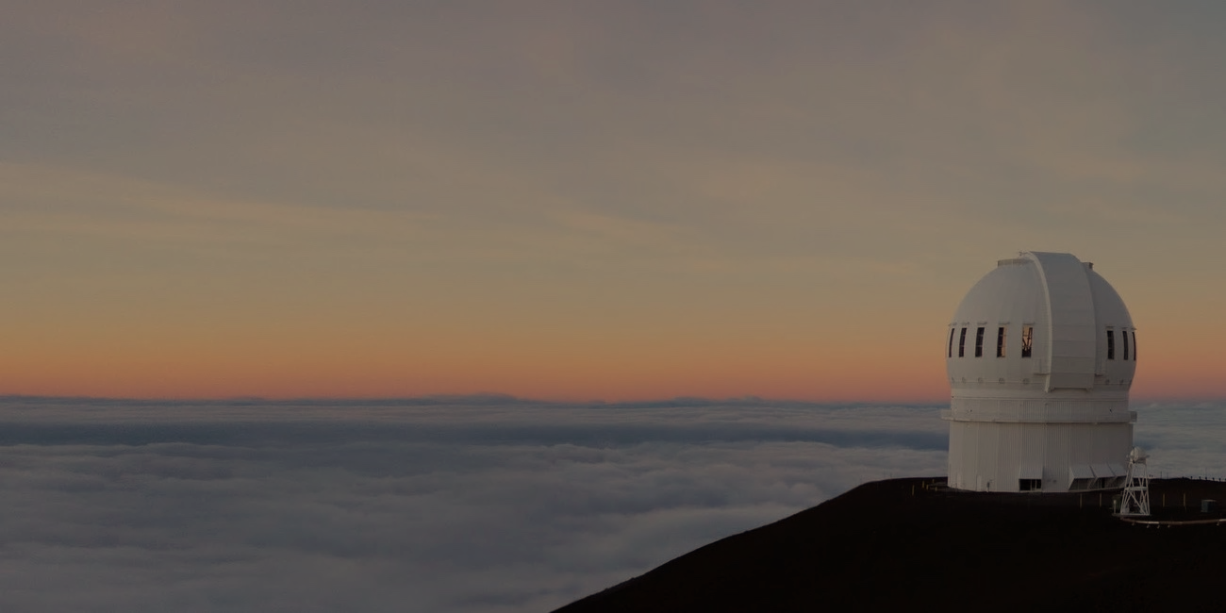
Vantage Success Through Value Delivery
Understanding platform characteristics
Performance
Quotas and Limits
Schema
Leads to successful migration decisions

Slide 23
Teradata + Public Cloud = Lowest Risk, Fastest Time to Value
Migrating to the same data model and Vantage software accelerates the journey to the cloud,
enables progress in advanced analytics and drives new value
Timeline for Teradata in Public Cloud
Premigration testing
Post migration tuning
ADVANCED AND NEAR-REAL TIME ANALYTICS POWERED BY VANTAGE
Bank of the Future
Cost Efficiency;
CX improvement;
Marketing, Sales & Care services digitization.
Migration delivered
Analytical value being delivered
Migration
Open data platform for business and digital partners
Discovery and analysis
Multi-channel, hyper-personalization of the Customer Journey
2021
2022
2023
2024
Timeline for other Cloud native database offerings
Parallel running to enable business continuity
Extensive re-engineering and parallel running drives high-cost;
Resources and management time diverted merely to re-implement existing functionality.
Data Structure Design
Migration and testing of 30+ high priority applications and associated ETL processes
Migration delivered
Ecosystem analysis
Develop and test new data structure
Rearchitect and develop downstream systems
Subject matter experts and data scientists tied up supporting migration

Slide 24

Questions and Answers

